Slide 1
1st Week Meeting
Urban Green Space Mapping Through Remote Sensing for Frankfurt/Main, Germany

Slide 2
Agenda
Creating the Ground Truth
Team Building
Some discussions that need to be started now:
Read-Out for mapping urban vegetation
Further Technical Requirements for the project
Questions

Slide 3
1. Creating the ground truth
Points to Discuss
Introduction of 3 Main Primary Data Sources
Detailed explanation how the Air Photographs will be used
Time constraints of processing different years in which air photographs were taken

Slide 4
Introduction of 3 Main Primary Data Sources
Frankfurt official cartography & Co.
Only includes public vegetation (a large part of vegetation can be expected to be private)
Detailed list of public trees
Open street map
Sparse tagging of private gardens for many neighbourhoods
Air photographs 20cm*20cm
Downloaded RGB images for 2023
Image sets for other years and near-infrared information, I need to apply for (started but want to confirm with you)

Slide 5
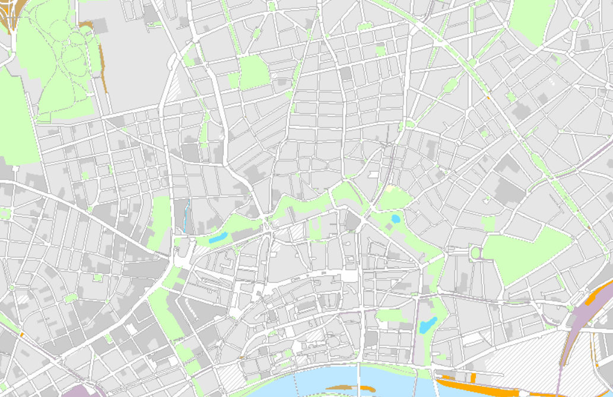
Frankfurt City Official Cartography

Slide 6
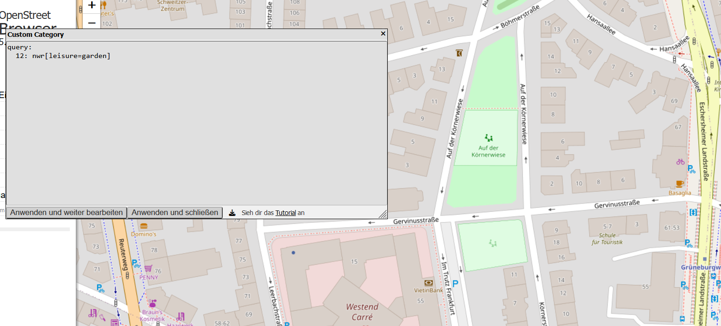
Open Street Map (Browser)

Slide 7
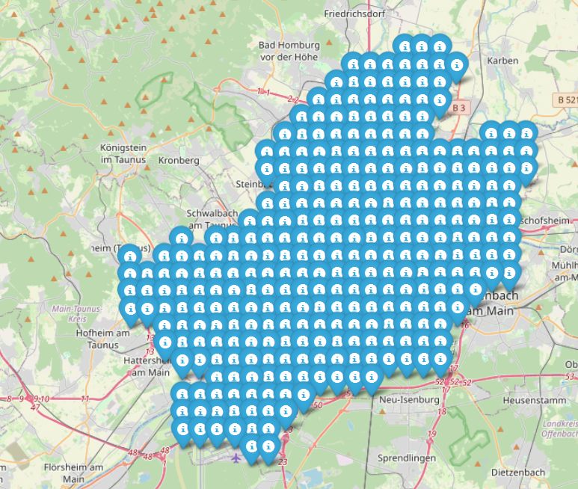
The air photographs are freely downloadable in RGB jpg format
Download location https://gds.hessen.de/
There are 310 photos sized 1 km x 1 km for Frankfurt
The files are in jpg format acconpanied by jgw files
Jgw files specify the lower left corner of the jpg images
Point coordinated were projected from EPSG:25832 to EPSG:4326 for visualisation
In the image to the lefft the point location of each upper left corner is shown
I have applied for tif-format images where the near-infrared channel is included

Slide 8
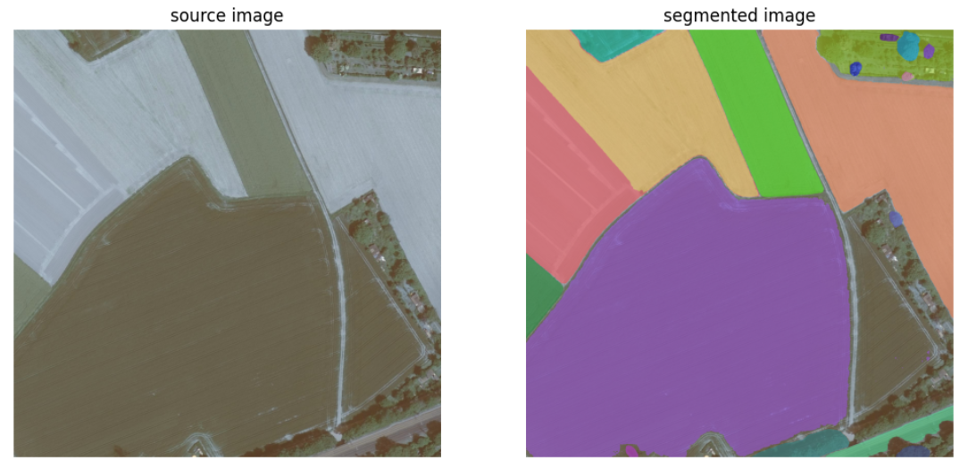
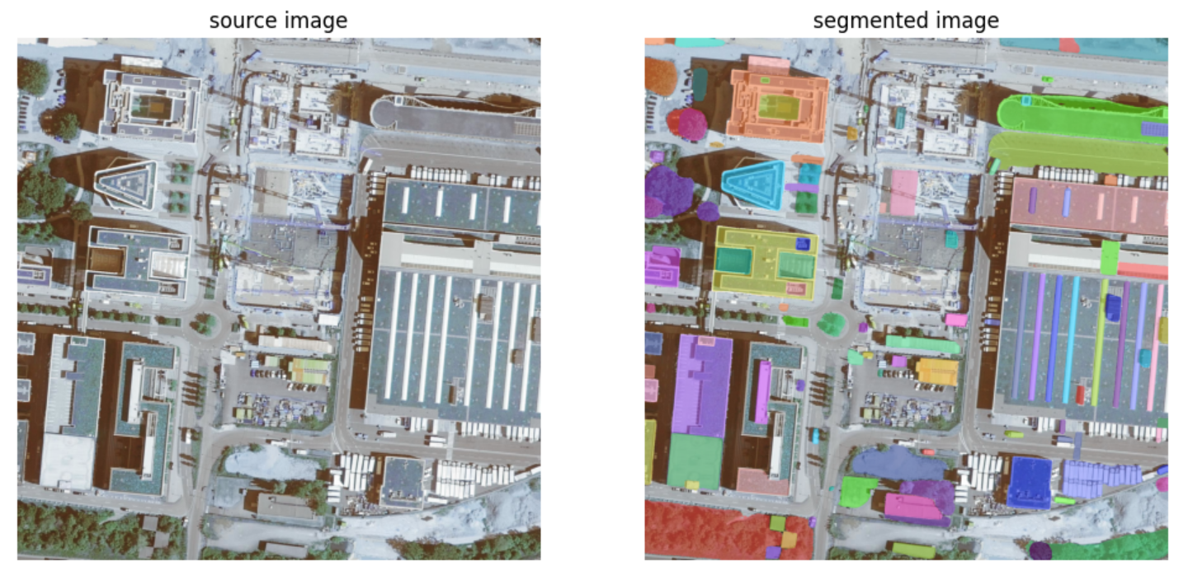
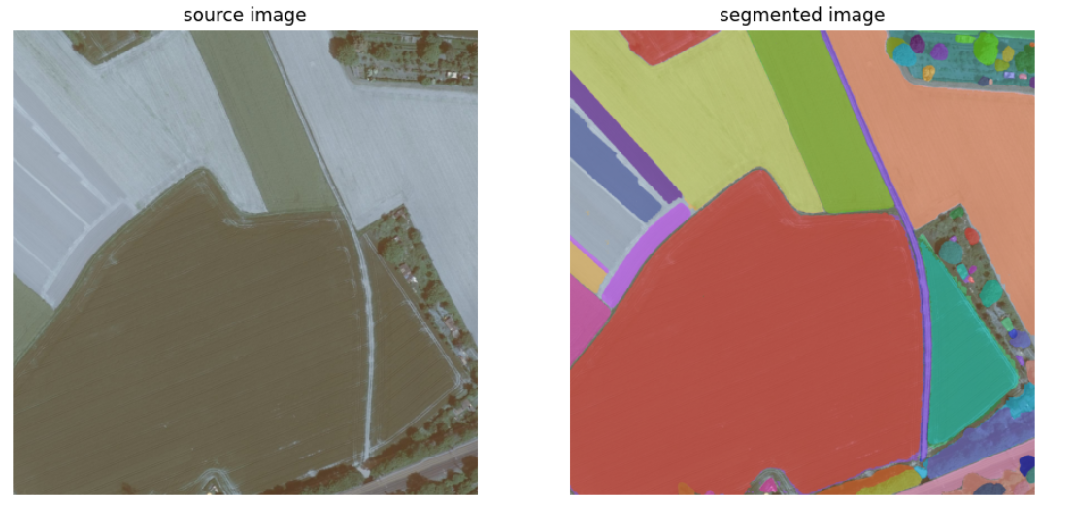
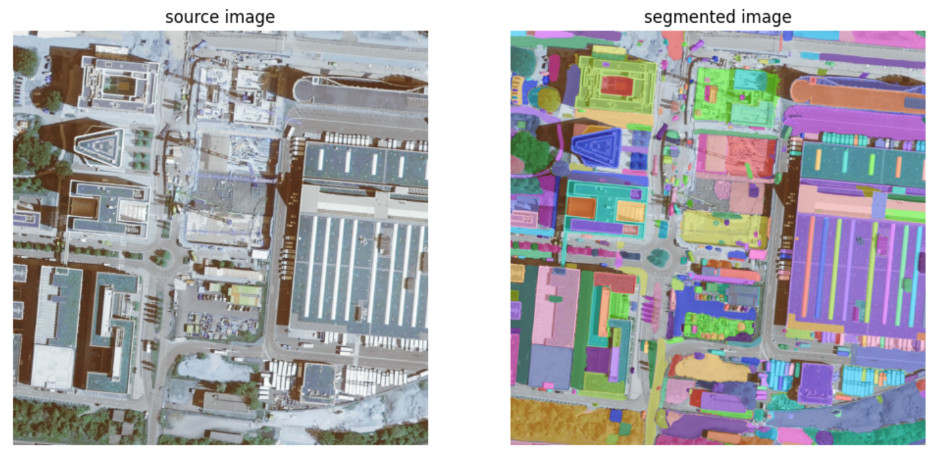
18 minutes per image with free 5 GiB free GPU capacity (Nividia) => ~48h

Slide 9
Proposed Workflow for creating „ground truth“ (reference data set)
Segment air photographs with SAM 2
Create vector-file maps from segmentation output
Peer review created maps
Who: Isabella and Dorothea – potentially 2 more volunteers with adequate hardware
Who: ideally 52 volunteers so that every volunteer gets 6 images
Who: ideally 52 volunteers so that every volunteer gets 6 images
How: use notebook adapted to local-machine set-up based on model creators‘ instructions (https://colab.research.google.com/github/roboflow-ai/notebooks/blob/main/notebooks/how-to-segment-images-with-sam-2.ipynb)
How:
- Receive original images with their segmentation outcomes (binary masks)
- Convert raster data of masks to vector data according to standardized protocol
- Cluster segments into pre-defined classes
- Inspect labelling visually using QGIS
How:
- Receive labelled vector maps and control them visually using QGIS

Slide 10
2. Team Building
Points To Discuss:
Do you have a preference working synchronized or asynchronous?
Dagshub vs. Github
When do you want to join team?

Slide 11
Project Plan – Weekwise
-> Participation in the preparatory phase is mandatory! Final access to data for deep learning is only granted to people who participated in it
Week 1: practice geospatial data and research methods
Week 2: hr green space map creation
Week 3: hr green space map creation and research
Join 1 out of 8 teams dedicated to a specifix deep learning technique
Spend the first weekk of researching your method in depth
Use low-resolution satellite imagery to precisely detect urban greenery
Present your progress weekly to the other teams
You will join 1 out of 8 teams
You will be provided an exercise sheet for practice
In parallel you will be required to evaluate provided literature if it is up-to-date and for its technical logic
You will join a new team
You will be provided code to extend green space mapping on open street map through 20*20cm air photographs
You will inspect visually precision of new map for a geographic area specified to your team
Based on your findings you will modify mapping code or not
Week 4-8: Deep Learning

Slide 12
Proposed Deep Learning Strategies
Team | Weeks 4-5 | Weeks 6-8 | Difficulty Level
A | Kernel-based MESMA | Clustering to unmix pixels | Beginner
B | U-net | U-net | Beginner+
C | U-net and Input amplification | U-net and Input amplification | Moderate
D | DL Method of Choice | DL Method of Choice | Advanced
E | SGU-MLP | SGU-MLP | Advanced
F | Mamba I | Mamba I | Moderate
G | Mamba II | Mamba II | Moderate
H | ***Analysis of Temperature, Vegetation, Topography*** | ***Analysis of Temperature, Vegetation, Topography*** | All Levels
One potential strategy could be to segment satellite images first into three classes: high urban greenery and low urban greenery (in analogy to the German benchmark datasets) as well as other areas
In a next step, other areas as well as border pixels of greenery segments would be pixel-level classified into the percentage of vegetation cover they contain
Lastly it could be tried to detect vertical greenery in off-nadir images (but that is unlikely that this works)

Slide 13
3.1 Read-Out for mapping urban vegetation
Points to Discuss:
Specifying target variable

Slide 14
Specifying target variable
Potential Open-Source Sensors: - Sentinel-2: Spectral Data
- Sentinel-1: Radar Data - Landsat: Spectral Data
Target Values (a blink into its diversity):
- Vegetation Area
- Vegetation Volume
- Aboveground Biomass
- Vegetation Density
- Leaf Area Index
- Some form of „Green index“
- Some measure of „Vegetation Structure“
- High- vs low-vegetation area as well as tree canopy cover
- indirect-vegetation measures such as impervious surface cover
- Fraction of private and public vegetation
Usefull Spectral Indices (a reminder): - NDVI
- EVI
- Green Chlorophyll Index (includes Green)
- Soil-Adjusted Vegetation Index
- Fractional Vegetation Cover: based on NDVI
- Normalized Difference Infrared Index (includes SWIR)
https://www.researchgate.net/profile/Sebastian-Lehmler/publication/371045067_Modelling_[…]?origin=journalDetail&_tp=eyJwYWdlIjoiam91cm5hbERldGFpbCJ9
Notes:
Vegetation infrastructure

Slide 15
Segmentation of Air Photographs
Low vegetation
High vegetation
No vegetation
-impervious
-pervious
-water

Slide 16
3.2 Further technical requirements for the project
Points to Discuss
Organisation of Download of Satellite Data

Slide 17
4. Questions?

Slide 18
Outcomes
Link to excel sheet for volunteers for annotation is gonna be shared in the slack channel
Link to doodle to vote about annotating 3 or 5 classes or other -> vote is open till Tuesday
Link to doodle to split into final teams will be shared
Teams can do annotations together

